Slide 1


Slide 2
About me
Shibel Alshech
22 years old
Isfiya
Computer Science student at The Open University
Student at 5TECH QA Automation program
PAGE 02

Slide 3

Asana - web application
Project Management: Asana is a web-based tool for project and task management.
Task Tracking: Allows users to create, assign, and track tasks and deadlines.
Collaboration: Enables team collaboration and communication on projects.
Integrations: Supports integration with various apps like Slack, Google Drive, and more.
User-Friendly: Features a user-friendly interface with customizable workflows.
PAGE 03

Slide 4
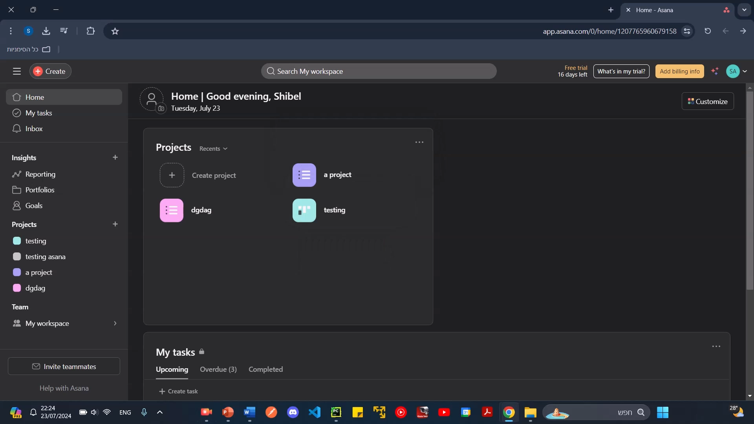

Slide 5
STP and STD Documents
At every QA Testing project, we need to prepare these two documents:
The STP objective is to plan the testing phase, set the elements to be tested, and set the time schedule, resources and all planning-related subjects.
In the STD document, we design the tests and build the test cases to ensure every step is properly executed to test what is needed.
Links to the documents: STP: Asana STD+STP\STP document.docx
STD: Asana STD+STP\STD document.docx
PAGE 05

Slide 6
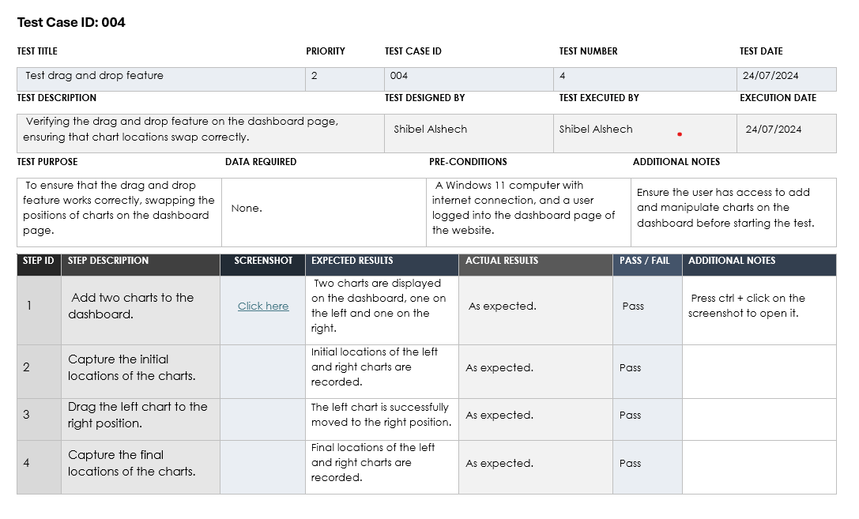
Test Case
PAGE 06

Slide 7
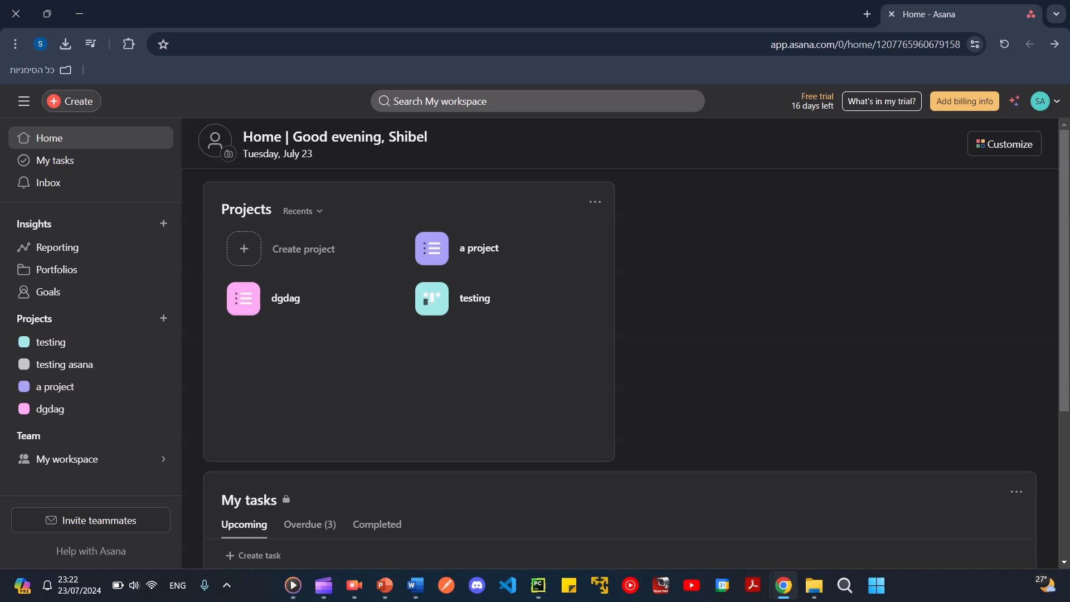

Slide 8
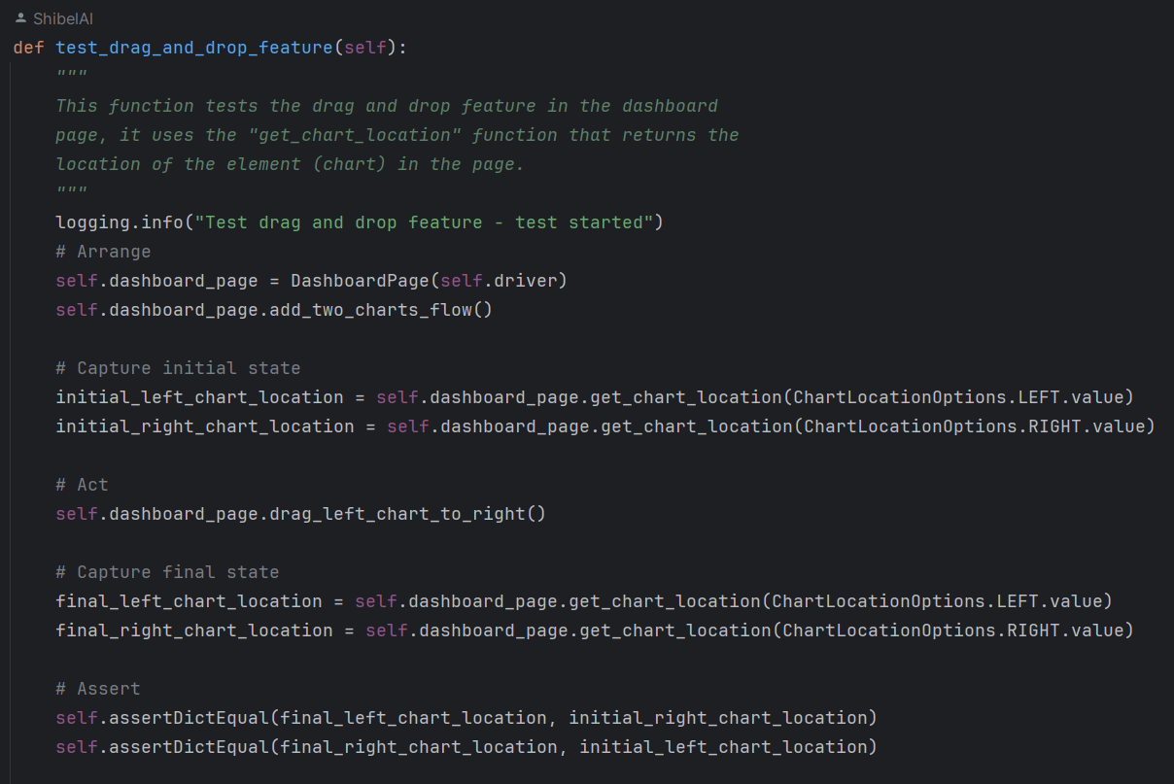
Now let’s see the code!
PAGE 08

Slide 9
Thank you for listening!
THANKS!

